Slide 1


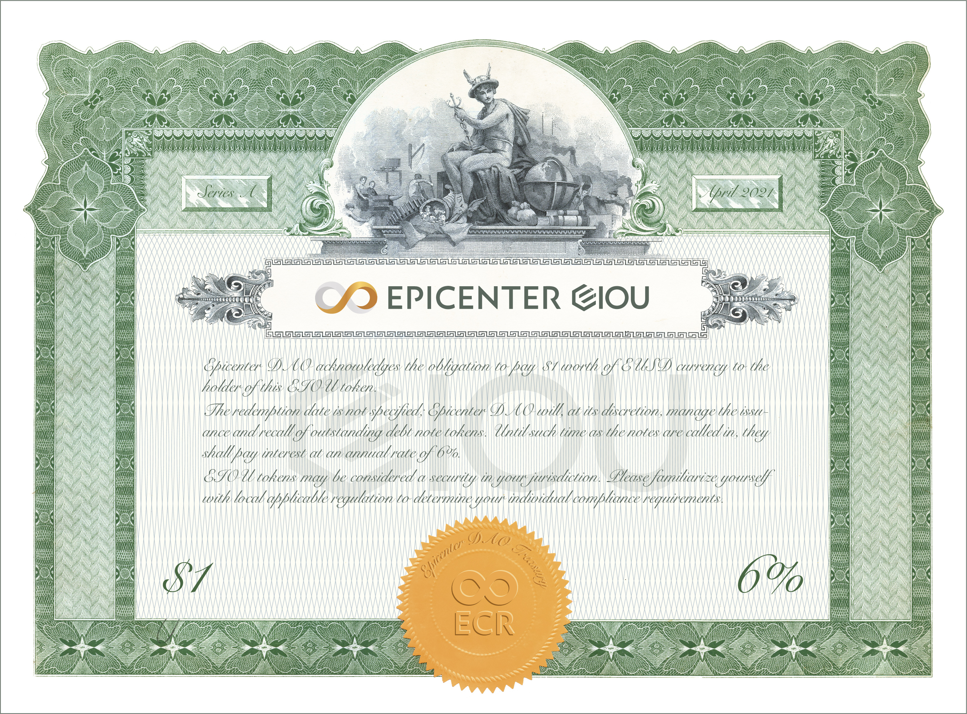
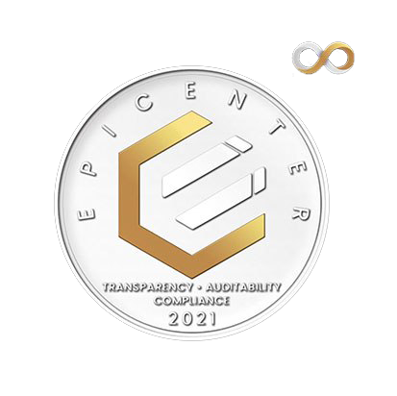





WHAT IS IT?
Epicenter IOU (EIOU) is a callable zero-coupon perpetual bearer bond. Each EIOU token will, upon call, pay $1 worth of EUSD.
Epicenter DAO, as per its treasury policy sets aside a portion of fee income to redeem outstanding bond tokens on a monthly basis.
In order to establish healthy and sustainable long-term credit markets, it is necessary to establish a “risk-free” rate of return benchmark. Epicenter DAO is determined to establish a sterling credit rating and reputation for solidity.
=$1
of EUSD at Maturity*
Learn more about the construction of a decentralized trustless yield curve
@FreemanU
*see eiou.epic.tech for full program terms
Milton F Freeman
https://eiou.epic.tech
@MiltonFFreeman
EC210501 – EIOU one pager v01

